Slide 1


Have you, or someone you know, had a stroke?
01872 266 997
mid@volunteercornwall.org.uk
www.volunteercornwall.org.uk

Slide 2
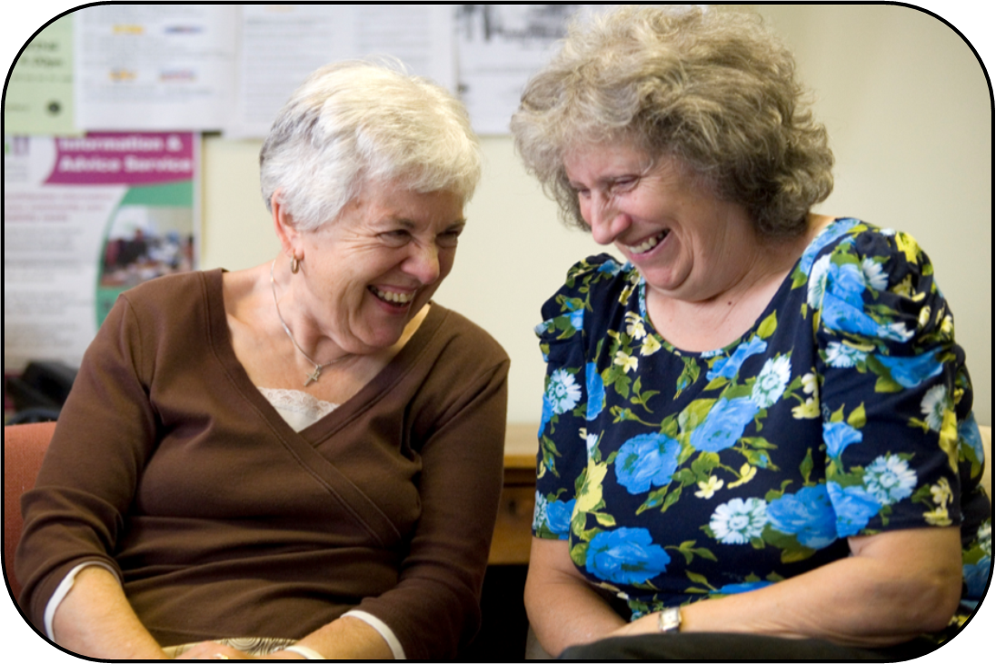
Then maybe you can help us…
01872 266 997
mid@volunteercornwall.org.uk
www.volunteercornwall.org.uk

Slide 3
… we are looking for Volunteer Stroke Befrienders
01872 266 997
mid@volunteercornwall.org.uk
www.volunteercornwall.org.uk

Slide 4
… to help recent stroke patients in their recovery journey
01872 266 997
mid@volunteercornwall.org.uk
www.volunteercornwall.org.uk

Slide 5
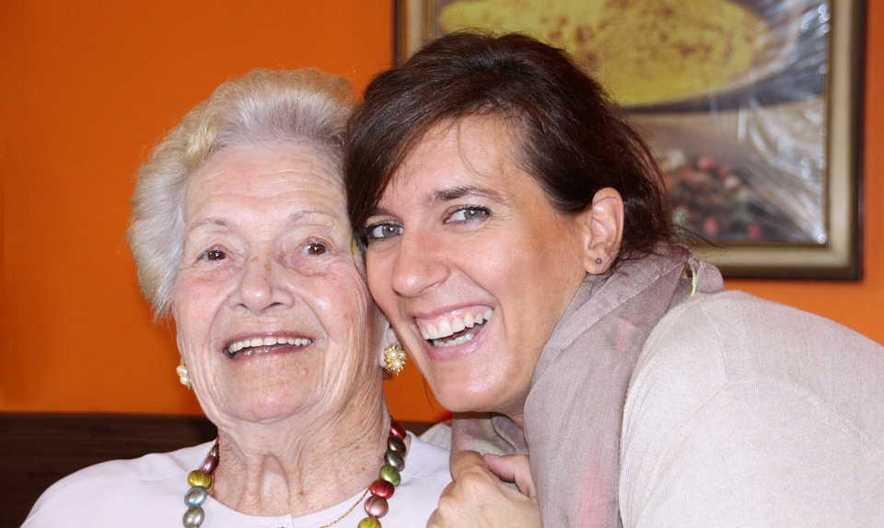
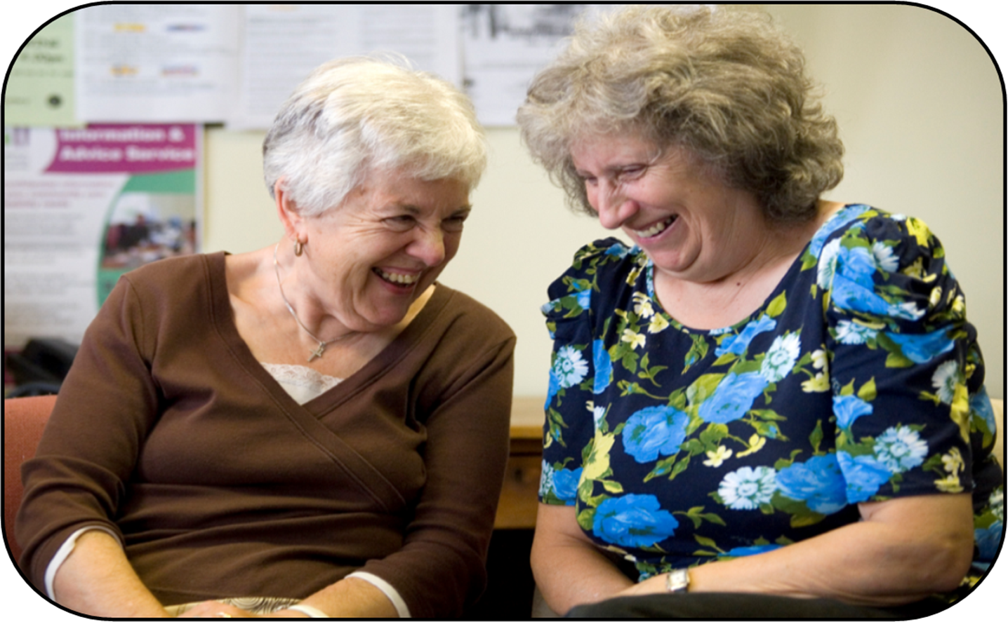
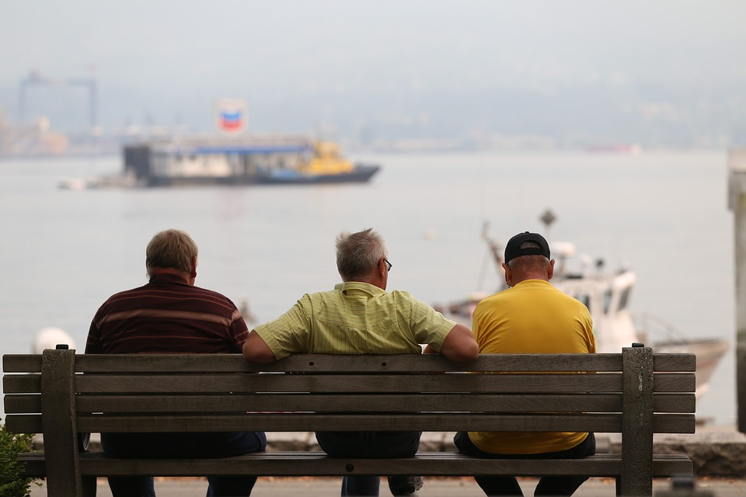
01872 266 997
mid@volunteercornwall.org.uk
www.volunteercornwall.org.uk

Slide 6
If you think you might be able to help please get in touch! ☺
01872 266 997
mid@volunteercornwall.org.uk
www.volunteercornwall.org.uk

Slide 7
Call us on
01872 266 997
01872 266 997
mid@volunteercornwall.org.uk
www.volunteercornwall.org.uk

Slide 8
Call us on
01872 266 997
or email
stroke@volunteercornwall.org.uk
01872 266 997
mid@volunteercornwall.org.uk
www.volunteercornwall.org.uk

Slide 9
We provide full training, support and can help with transport.
01872 266 997
mid@volunteercornwall.org.uk
www.volunteercornwall.org.uk

Slide 10
“I enjoy meeting people and feeling valued again” – Margaret, Volunteer Stroke Befriender
01872 266 997
mid@volunteercornwall.org.uk
www.volunteercornwall.org.uk

